Slide 1
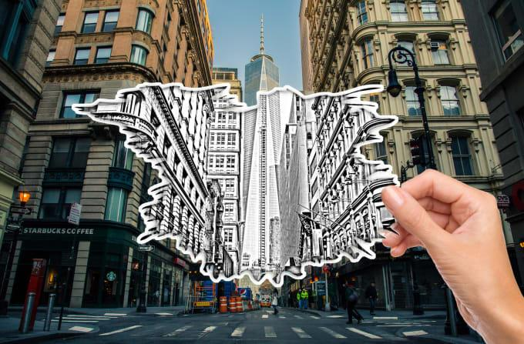
Project Title
Awesome Typography:
Statistics-Based Text
Effects Transfer
Team 31:
255 Shades of Gray
Team members:
Samartha (2018101094)-CSE
Abhiram (2018102036)-ECE
Nihar (2018102039) -ECE
Tushar (2018102041)-ECE
Mentor TA :
Surendra Kumar
Repo URL :
https://github.com/Digital-Image-Processing-IIITH/project-255-shades-of-gray

Slide 2

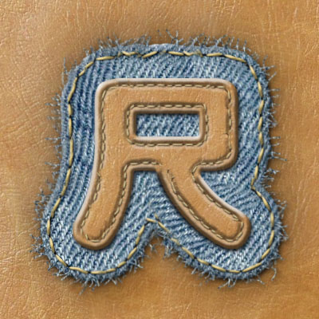



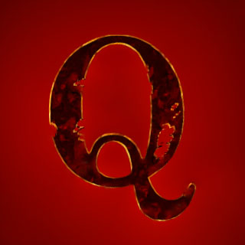

Introduction...
It is often a good practice in Publishing and advertising to use special effects to the text to make it more attractive. But this task is very cumbersome as it requires experienced designers and advanced editing skills, and also a lot of time for getting a visually plausible output.
The aim of the paper is to generate fantastic special effects for typography by using few Image processing Techniques, which will be discussed in the subsequent slides.

Slide 3
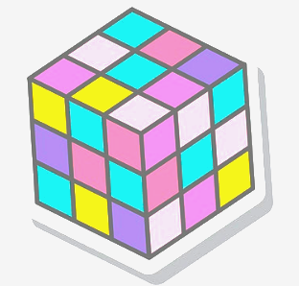



Problem Statement
Text effects transfer takes a set of three images as input :
Raw Source Image, S
Source Stylised Image S’
Raw Target text image T
Now, we should generate target stylised image such that S:S’::T:T’ We deal this problem in 4 steps, let us see how ...
S0
S’
T
T’

Slide 4

Procedure
The paper divides style transfer into different sections which are summarized in the following slides as follows
Patch partitioning
Optimal patch scale detection
Posterior probability estimation
Effect transfer

Slide 5
Patch partition

Slide 6

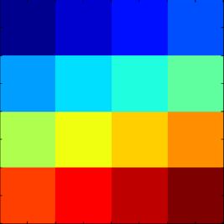
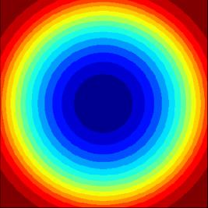
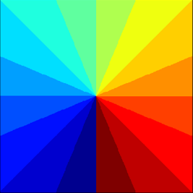
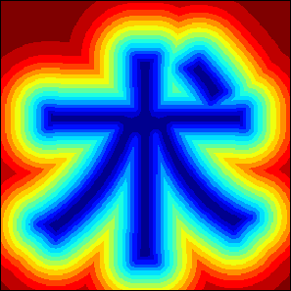
Patch Partitioning
Different partition modes explored
Patch is a segment of image, which is used for style transfer. We have to identify patches first, to use it for style transfer. Generally, patch patterns are highly dominated by their locations.
We identify pattern of a patch by two factors :
Pixel color
Patch scale
Grid
Ring
To quantitatively evaluate the location of patches we divide the image into say, N partitions. The paper discusses about the given partition methods and their effectiveness in partitioning the patches in the stylized images. (Distance here is distance from skeleton)
Angle
Distance

Slide 7
Patch Partitioning
For finding the best partition method, the researchers have done the following. The training accuracy of an SVM which was trained on the images to classify the the color/scale, given type of partition was measured for a group of images, it turned out that the accuracy is highest for Distance based partitioning. (ref. Table 1 in paper)
r | Random | Grid | Angle | Ring | Distance
Color | 0.063 | 0.106 | 0.119 | 0.105 | 0.147 *
Scale | 0.153 | 0.793 | 0.486 | 0.590 | 0.950 *

Slide 8
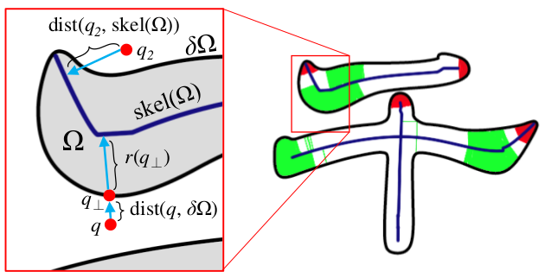
Distance Partition
Problems
We find the distance transform from the skeleton to classify the pixel into different patch levels.But there are two problems with this :
Not invariant to text radius
Distances at sharp or flat regions (as in red region of image)
To make the distance width invariant, we normalise the distance of every pixel with distance of nearest point on contour from it (called text radius).
This might give varying results in the sharp or flat regions, instead we normalise with an estimate of text radius.
Problems with general Distance Transform

Slide 9
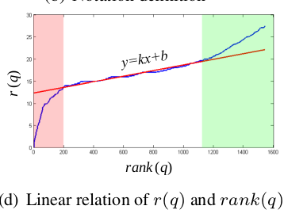
Distance Partition
Modifications
Estimates are found from the regression line. We remove the outliers which cause irregularities (red and green regions in image) we assume them to be leftmost 20% points
Pixels in Text Region
Pixels on Boundary
Boundary pixel count

Slide 10
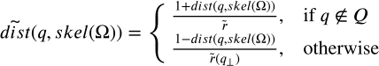
Distance Partition
Width correction
Here,
Is the nearest pixel to along 𝜹𝝮
Is the mean text
Notations,
Pixels in Text Region
Text width (shortest distance from boundary to given pixel)
Pixels on Boundary
Text width (shortest distance from boundary to given pixel)
Boundary pixel count

Slide 11
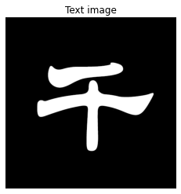
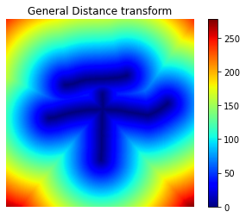
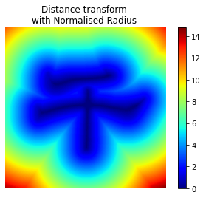
Distance Partition
End Result
We can observe the difference between outputs of both transforms, which clearly tell us that Normalised distance better preserves the shape information compared to the general Distance Transform (observe the highlighted regions)

Slide 12
2. Optimal Patch Scale Detection

Slide 13

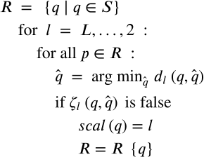
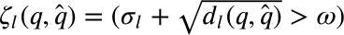
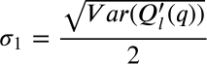
Optimal Patch Scale Detection
Scale of the patch is the size of the patch that we are using for style transform. We determine the scale of the patch centered at pixel “q” by using the following algorithm. (This algorithm acts like a multi-level - coarse to fine sieve)
Where, q̂ is correspondence of q at scale l given by
And 𝜻_{l} is the truth value of
where,

Slide 14
Optimal Patch Scale Detection
Where, q̂ is correspondence of q at scale l given by
And 𝜻_{l} is the truth value of
where,
Q’_{l}(q) is the patch centered at q at scale l which is done by downsampling the image

Slide 15
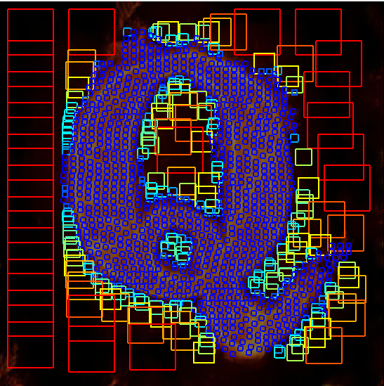
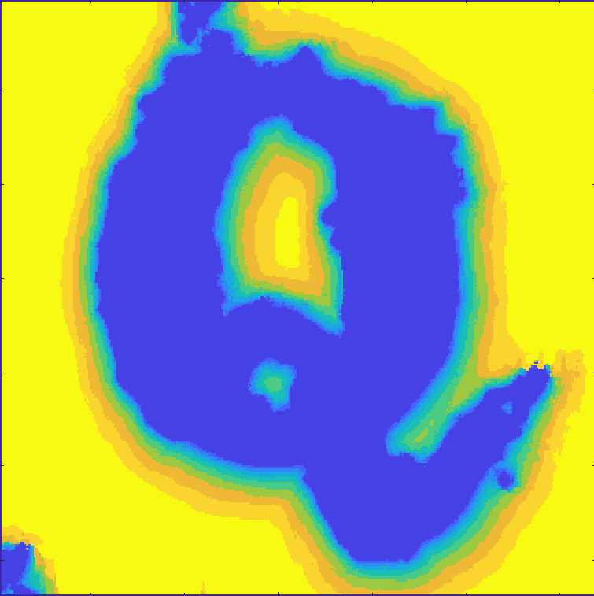
Optimal Patch Scale Detection
End Result
Patch Scale Visualised
Optimal Scale Map

Slide 16
3. Optimal scale Posterior probability estimation

Slide 17
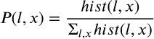
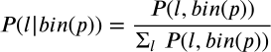
Optimal Scale Posterior Probability Estimation
As we know that there is high correlation between patch patterns and their spatial distributions, we derive posterior probability of optimal patch scale given the partition it belongs to. For this we quantize the distance transform of the image into 100 bins.
This is done in 3 steps and mathematical expressions are as follows:
Calculating 2D histogram of distance and scale
Estimating joint probability of distance and scale
Calculating posterior probability of scale given distance

Slide 18
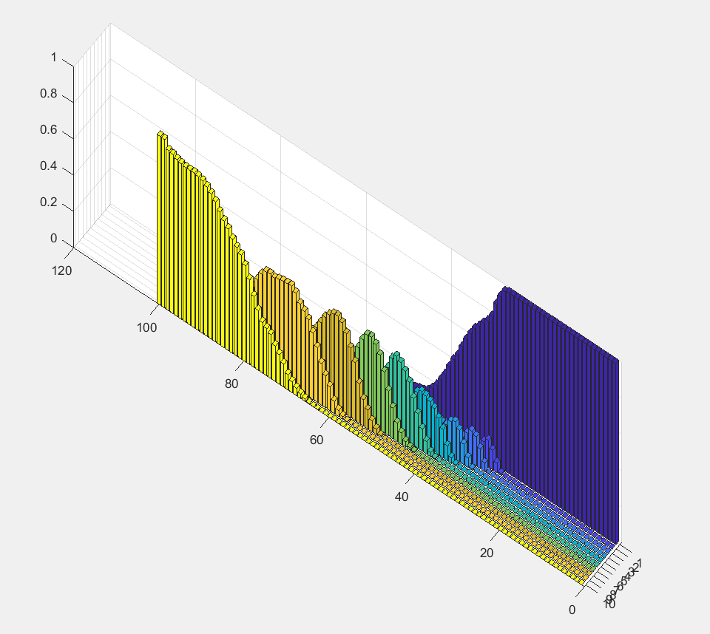
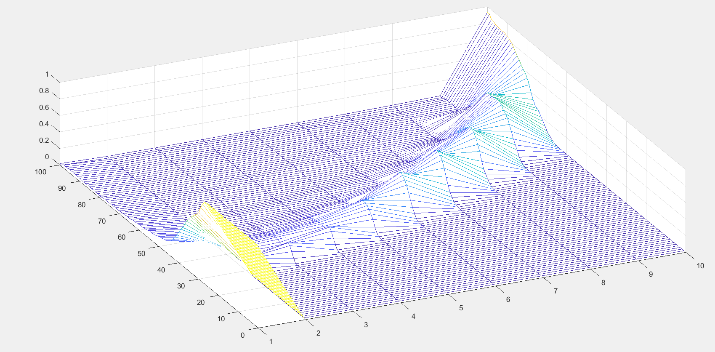
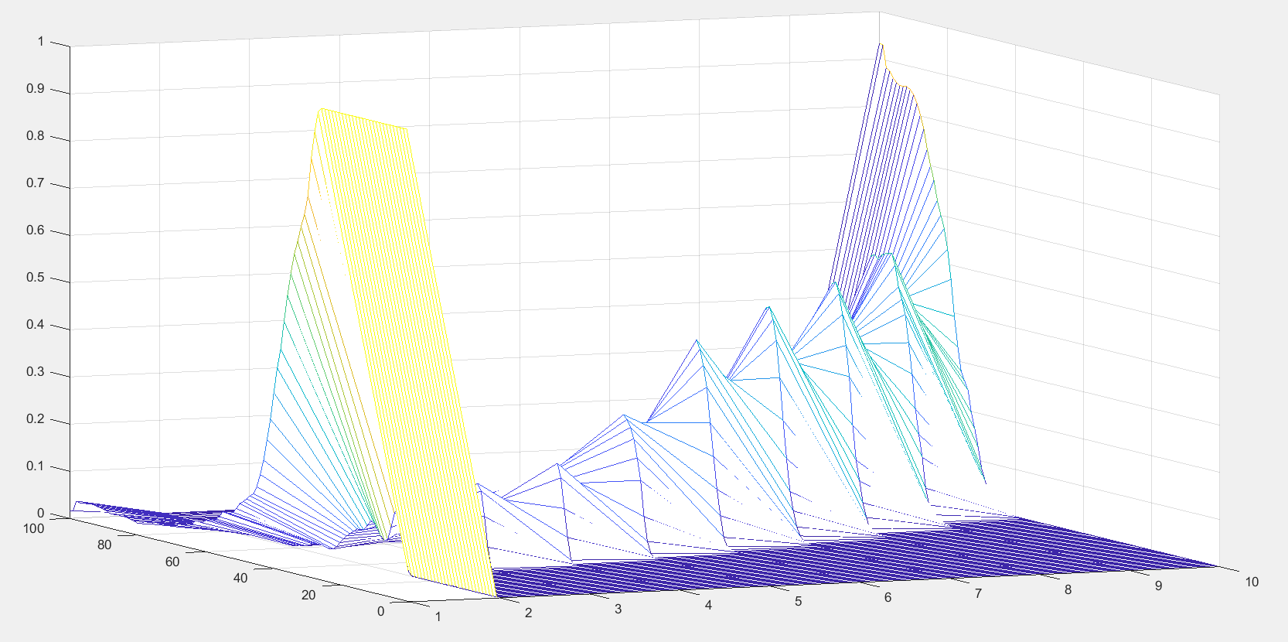
Optimal Scale Posterior Probability Estimation
Histogram of distance and scale
Posterior Probability graphs

Slide 19
4. Style Transfer

Slide 20

Style Transfer
Style transfer occurs from patches in source image to patches in target image using an optimization function to perform texture synthesis. Optimization function from paper [2] is taken as reference with a few custom modifications. Keep it somewhere :P
We have three criterion for transfering style,
Appearance term
Distribution term
Psychovisual term
This is similar to histogram matching. The objective function is as follows,

Slide 21

Appearance term
Texture transfer
The main purpose of the appearance term is :
Preserve coarse grained structures
Preserve texture details

Slide 22
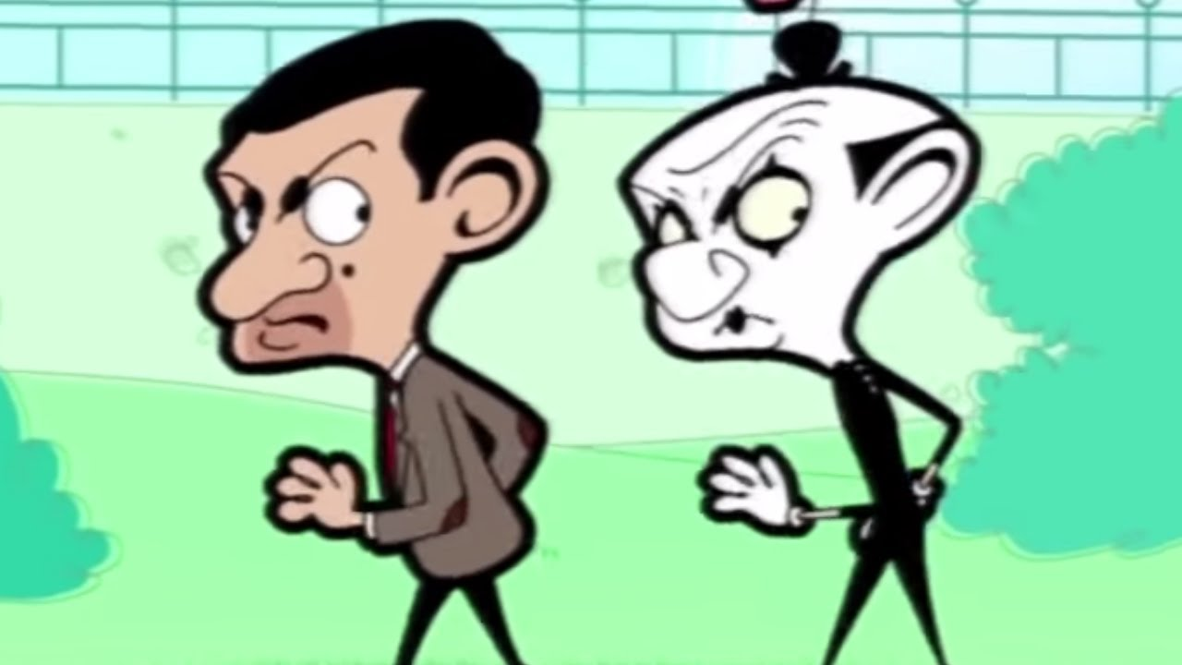
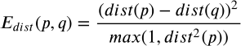
Distribution term
Spatial style transfer
This term ensures that the distribution of sub-effects in the target image and source example are similar, which is the basis for our assumption in Optimal Scale Probability Estimation section that posterior probabilities p(l|x) in T’ and S’ are same.

Slide 23
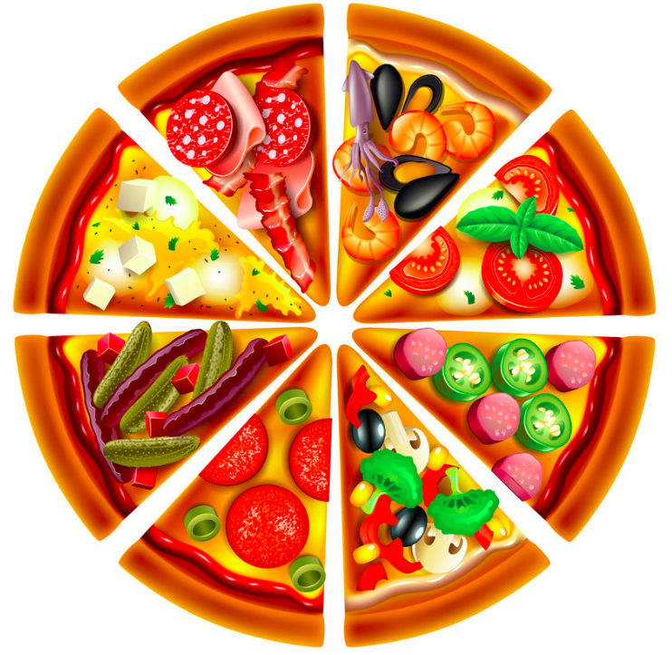
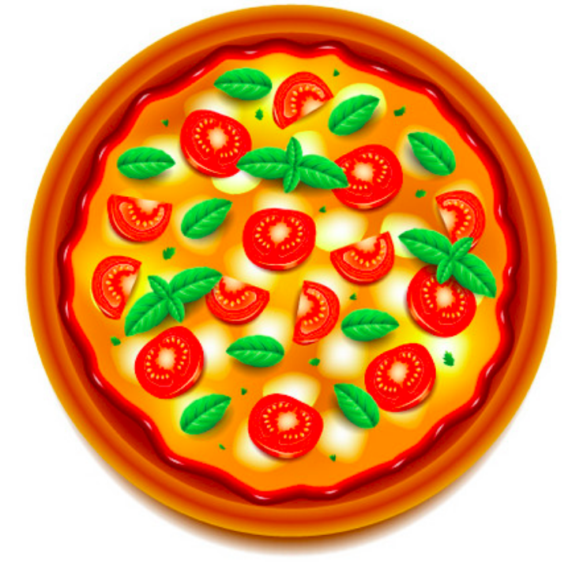
Psychovisual term
Avoiding Repetitiveness
We do not want the same pattern to repeat again and again, so we penalise repetitions. This is done by adding the following term to the objective function.

Slide 24
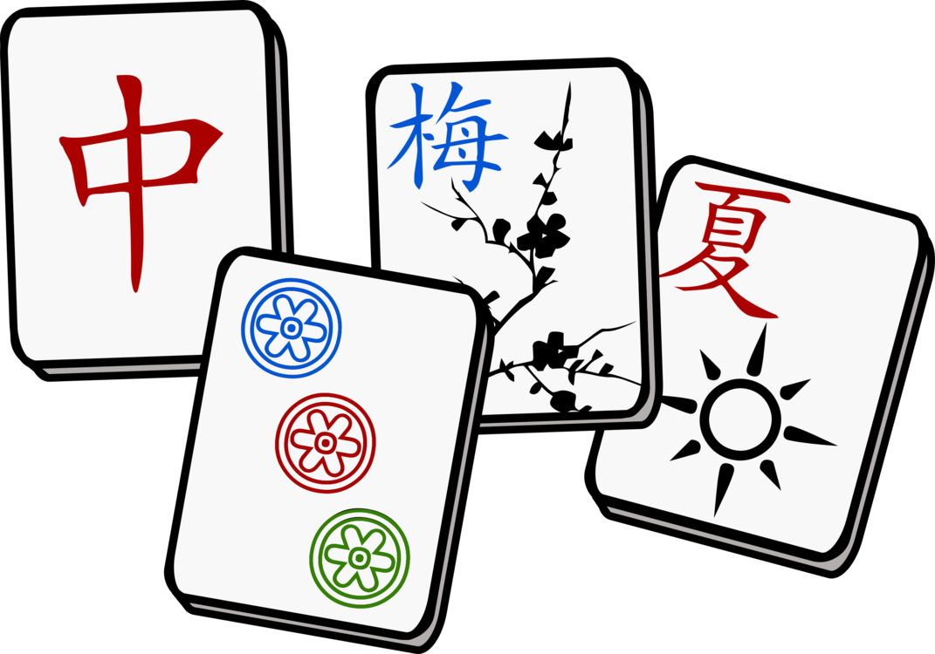
Style Transfer
Matching
Nearest Neighbour Field (NNF) mapping algorithm is used to find the patch correspondences. We search with random offset and adjacent offsets search cooperatively. NNF is initialized randomly or using prior information.
Each iteration of the algorithm proceeds as follows: Offsets are examined in scan order (from left to right, top to bottom), and each undergoes propagation followed by random search.
Propagation - Choosing the offset in the NNF which reduces error. (general iteration step of an optimization problem)
Random Search - We try to improve the estimate by testing a sequence of candidate offsets which are at an exponentially decreasing distance from the current estimate.

Slide 25

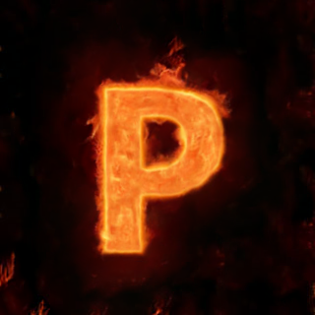





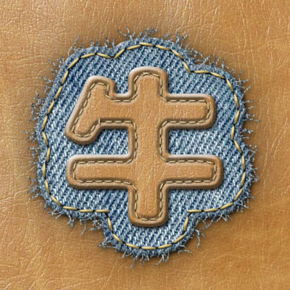

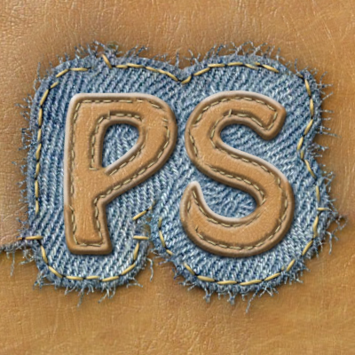
Sample Final Outputs
S
S’
T
T’

Slide 26

Work division:
Theory :
Section 3.1 : Problem Formulation & Analysis
Lead : Samartha
Section 3.2 : Statistics estimation
3.2.1 : Lead : Samartha
3.2.2 : Lead : Tushar
3.2.3 : Lead : Nihar
Section 3.3 : Style Transfer
Lead : Tushar
Implementation :
Section - 3.2:
3.2.1 : Main Algo : Abhiram
: KNN search : Samartha
3.2.2 : Lead : Tushar
3.2.3 : Lead : Nihar
Section 3.3 :
Lead : Nihar
Presentation :
Lead 1 : Abhiram
Lead 2 : Nihar
Documentation :
Lead 1 : Samartha
Lead 2 : Tushar
Dataset :
Lead : Tushar

Slide 27

References
[1] Shuai Yang, Jiaying Liu, Zhouhui Lian, Zongming Guo; Proceedings of the IEEE Conference on Computer Vision and Pattern Recognition (CVPR), 2017
[2] Y.Wexler, E.Shechtman, and M.Irani. Space-time completion of video. IEEE Transactions on Pattern Analysis and Machine Intelligence, March 2007.
[3] C. Barnes, E. Shechtman, A. Finkelstein, and D. B. Goldman. Patchmatch: a randomized correspondence algorithm for structural image editing. ACM Transactions on Graphics, August 2009.

Slide 28

A Picture is worth a Thousand words

